Slide 1


The Institute of Chartered Accountants of India
(setup by an Act of Parliament)
COMMITTEE ON CAREER COUNSELLING

Slide 2


The Institute of Chartered Accountants of India
ICAI – Excellence | Independence | Integrity
  A statutory body established by an Act of Indian Parliament
  “The Chartered Accountants Act,1949”
  More than 75 years of existence, ICAI has achieved recognition as a premier accounting body globally
  ICAI is the largest Accounting Body in the World.

Slide 3

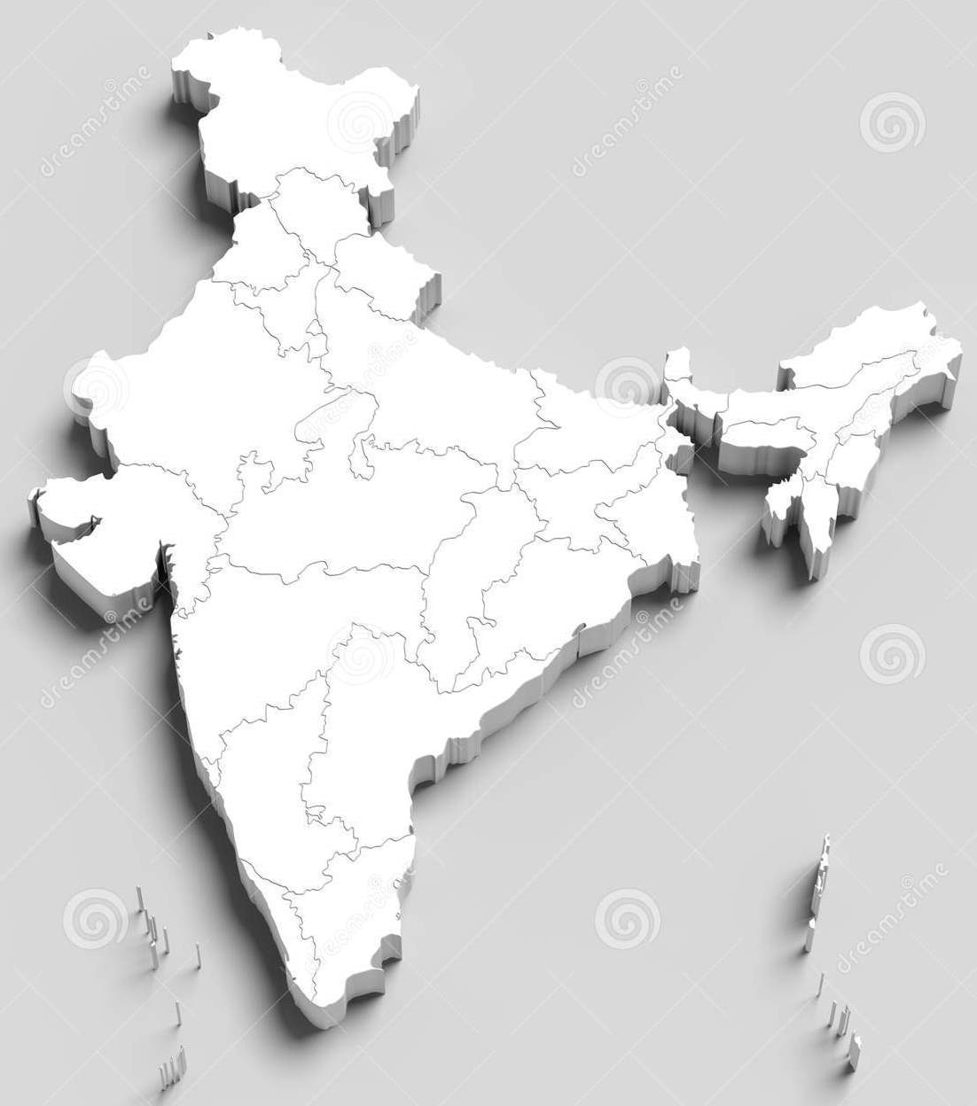




ICAI – Infrastructure
Human Resources # 1200+
Branches # 168
Foreign Chapters # 45
Branch Own Buildings # 101
Auditoriums#45 & Seminar Halls # 98
(Approximate capacity # 22890+)
Information Technology Centres # 162
(Computers for students undergoing ITT, Advance ITT 6530 Plus)

Slide 4
सात महाद्वीपों की एक भाषा … लेखांकन (लेखाकर्म)
7 Continents..
1 Language
Accountancy

Slide 5
ICAI Partner in Nation Building
Chartered Accountants
are a bridge between
People and the Government.
Public
Government

Slide 6

THE IMPORTANCE AND IMPACT OF CA AS A PROFESSION
A CA’s Pen is mightier than a Sword
As Finance Professionals - Finance is the back bone of any enterprise and CA’s enable the same in Accounting, Reporting and Control roles
As Auditors - There is no Second Opinion on a CA’s opinion on a financial statement

Slide 7
Dream CA Believe CA Achieve CA
Economic well- being
Reputation
International exposure
Good social stature
Attractive career options
Dedicated professional
CA student

Slide 8
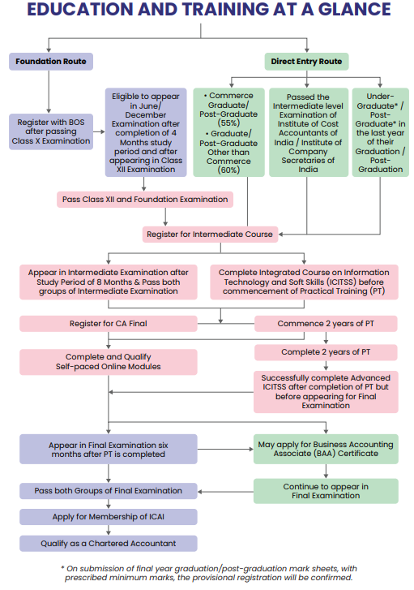

Slide 9
FEE STRUCTURE – (Including Study Materials)
FOUNDATION COURSE
Foundation Registration Fees - Rs. 9000
INTERMEDIATE COURSE
Registration Fees - Rs 15000
Students’ Activities Fees - Rs 2000
Registration fees as Article Assistant - Rs 1000
Total Fees - Rs. 18000
FINAL COURSE
Final Registration Fees - Rs. 22,000
Total Fees - Rs. 22,000
ICITSS Fees
i. Course on Information Technology - Rs. 6,500
ii. Orientation Course - Rs. 7,000
Advanced AICITSS)
Course on Advanced Information Technology - Rs. 7,500
Management & Communication Skills Course - Rs. 7,000
OTHER FEES
TOTAL FEES
TOTAL FEES - Rs. 77,000
75% Concession in Registration Course Fee for all levels of CA Courses for the Candidates/ Students from Union Territories of Jammu & Kashmir, Ladakh, 8 North-Eastern States & Andaman and Nicobar Island.
Wards of deceased members have been given 75% concession in Registration Course Fee for all levels.

Slide 10

MANTRA OF BECOMING A CA
HARDWORK
DEDICATION
CHARTERED ACCOUNTANT

Slide 11
OPPORTUNITIES FOR CAs
Own Practice | Job /Employment
Entrepreneurship / Business | Further Studies/ UPSC/ Management
While presenting the interim budget of 2020-21, CA. Piyush Goyal, Hon’ble Minister for Railways and also given additional charge for Ministry of Finance said “We are poised to become a 5 trillion-dollar economy in the next 5 years and aspire to become a 10 trillion-dollar economy in the next 8 years” thereby implying that the role of Chartered Accountants is only going to get more important from here on and there could be a dearth of about 25000 professionals in the market in the future.

Slide 12
A CA can serve in all possible avenues of Commerce
Commerce
Entrepreneur
Management Consultancy services
CHARTERED
ACCOUNTANT
Information Technology consulting
Business
Advisory services
Government
Advanced finance and economics
Academics

Slide 13
Earn while you Learn
(Minimum stipend)
Stipend to Articled Assistants
 | Classification of the normal place of service of the articled assistants | Stipend payable per month in (₹) during training
 |  | First year | Second year | Total Stipend for Two Years
1. | Cities/Towns having population of 20 lakhs and above | 4,000 | 5,000 | 1,08,000
2. | Cities/Towns having population of 5 lakhs and above but less than 20 lakhs | 3,000 | 4,000 | 84,000
3. | Cities/Towns having population of less than 5 lakhs | 2,000 | 3,000 | 60,000

Slide 14
ICAI SCHOLARSHIP SCHEME
Sr. No. | Scholarship Category | Amount (p.m.) | Eligibility Criteria
1 | Need based for economically weaker Intermediate students | Rs. 1,500/- | Students who are registered for Intermediate course and income of parents should not be more than Rs. 3,00,000 p.a.
2 | Need based for economically weaker Final students | Rs. 1,500/- | Students who are registered for Final course and income of parents should not be more than Rs. 3,00,000 p.a.
3 | Merit cum need based Scholarship | Rs. 2,000/- | Rank-holders of Intermediate Exam who has registered themselves for the Final course (other than those covered under Merit Scholarship and income of parents should not be more than Rs. 3,00,000 p.a.
4 | Merit Scholarship | Rs. 2,500/- | Rank-holders of Intermediate Exam, whose name appears at sr. no. 1 to 10 and in case the rank continues to further ranks i.e. to sr. no. 11 or to sr. no. 12 or so on, then all such rank holders.
NOTE: Students can apply online anytime for the Scholarship by login at Self Service Portal (SSP) at https://eservices.icai.org . In case of any clarification, please contact at Ph: 0120-3045914, please visit our website at www.icai.org

Slide 15
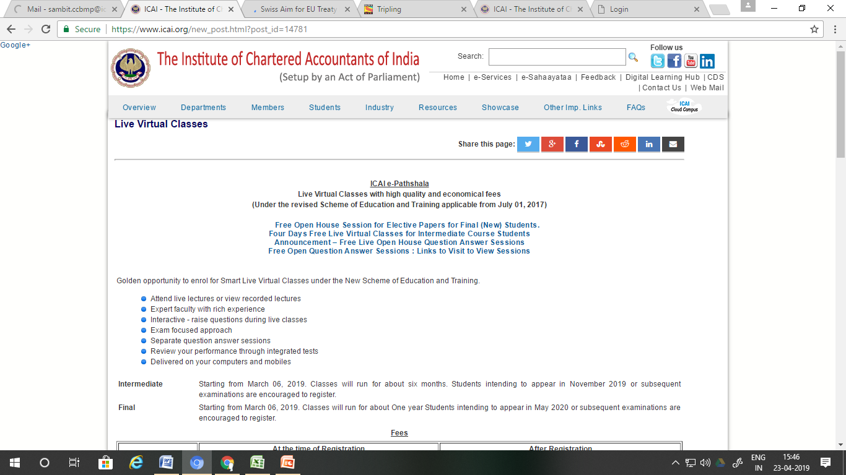
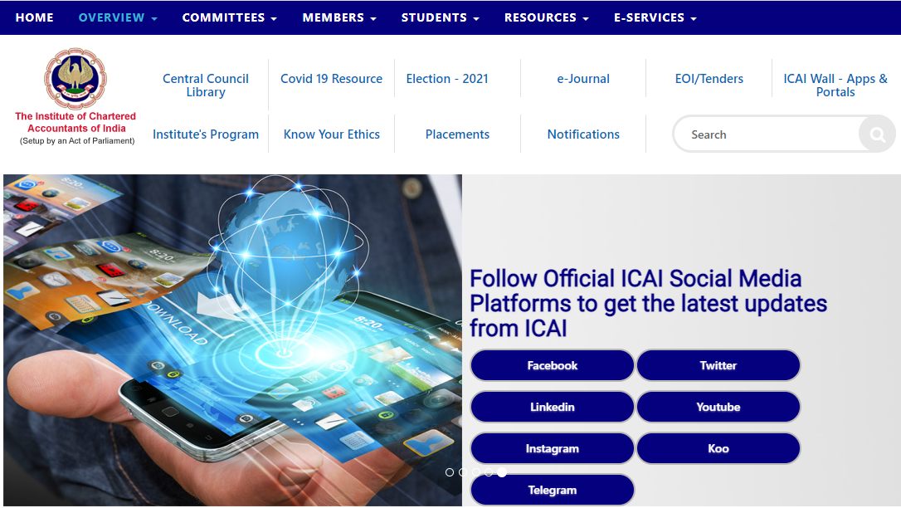

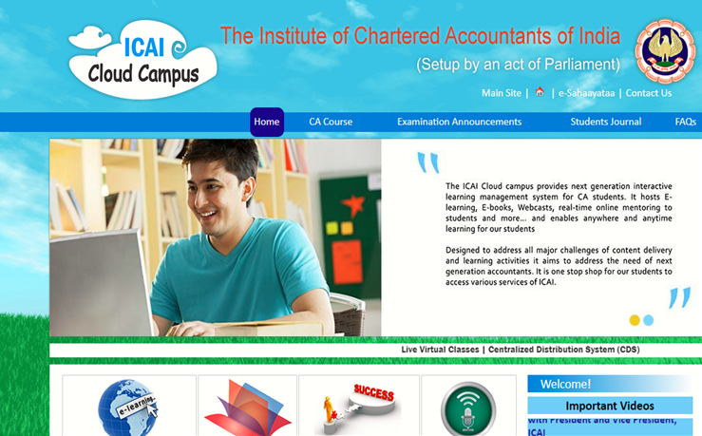
ICAI’s Virtual Classes, e-Learnings and Cloud Campus facilities
1
2
https://www.icai.org/new_post.html?post_id=14781
https://www.icai.org/
3
4
https://learning.icai.org/elearning
https://cloudcampus.icai.org/

Slide 16
Campus Placement Programme-
A Bird’s Eye view
Campus placements organized two times every year participated by leading companies and CA firms. The highest domestic salary is INR 28 Lac (Per Annum).
TOP MAJOR SECTORS DURING CAMPUS PLACEMENT IN FEBRUARY-MARCH 2023
BANKING | FAST MOVING CONSUMER GOODS (FMCG)
INSURANCE | INFORMATION TECHNOLOGY- SOFTWARE
PHARMACEUTICAL COMPANY | MANUFACTURING
AUTOMOBILE MANUFACTURER | MULTINATIONAL CONGLOMERATE COMPANY
CHARTERED ACCOUNTANCY FIRMS | CHARTERED ACCOUNTANCY FIRMS AUTOMOBILE MANUFACTURER

Slide 17

USP of CA profession
Established by an Act of Parliament
Regulator of audit and assurance functions
Open for all streams: Commerce/Arts/Science
Elements of theory & practice in 2 years Articleship
Offers opportunities for distance learning
Age is no bar (As in any age, anyone can register in CA Course)
Meritocracy
Equal opportunity for all
Standardized course with regular updates
Cloud campus for students
Campus placement
Employment
(Attractive career options)
Ability to multitask
Great learning at minimal cost
Catalyst in economic policies

Slide 18






Your path to success: Built on a foundation of meritocracy
Contribute to corporate/banking laws, governance and economic policies
Participate in social initiatives such as Swachh Bharat Abhiyan, Swachhta hi seva campaign, Swachhata Pakhwada etc.
Leadership positions in the public and private sector
Manage a CA practice that offers audit, assurance, taxation, management accounting & advisory services.
Start a business from scratch and take it to unprecedented heights as an entrepreneur
Attractive remuneration in employment

Slide 19

Power of CAs Signature
Tax Audit
(under Income Tax Act & GST Act)
Forensic Audit
Company Audit
(under the Companies Act)
Foreign Currency Remittances
(as per FEMA)
Various other ‘Assurance’ services (Required by statutes of Central Government, State Governments, Local Authorities)
These are the areas in which it is mandatory to get documents certified by a Chartered Accountant
“Your signature is more powerful than PM's and Government also believes the Accounts signed by you.”
-Shri Narendra Modi, Hon’ble Prime Minister,
(while addressing Chartered Accountants after announcing GST, Business Today, July 2017.)

Slide 20
Recognition for CA Course
1- Equivalence to Post-Graduation
i. The University Grants Commission (UGC) granted academic equivalence to the Chartered Accountancy qualification with its Post Graduate degree, for appearing in the UGC National Eligibility Test (NET) vide D.No.9-35/2016(CPP-II) dated 15th March, 2021. Details are available at link: https://www.ugc.ac.in/pdfnews/2480829_CACSICWA-Public-Notice.pdf
ii. The Association of Indian Universities (AIU) has recognized the Chartered Accountancy qualification with Graduations equivalent to post graduate degree in Commerce or allied discipline for pursuing Ph.D. programme.
112 Universities have recognized the Chartered Accountancy qualification as equivalent to Post Graduation for registering the members to the doctoral programme (Ph.D.) including:
The Indian Institute of Management (IIM) Ahmedabad, Bangalore, Kolkata, Lucknow, Kozhikode, Shillong and Jammu
Indian Institute of Technology (IIT) Madras and Bombay Details can be accessed at Link: https://resource.cdn.icai.org/26417bos15829.pdf.
2- The Union Public Service Commission (UPSC) has recognized Chartered Accountancy Qualification for admission to Civil Services examination.

Slide 21
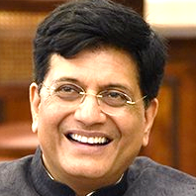
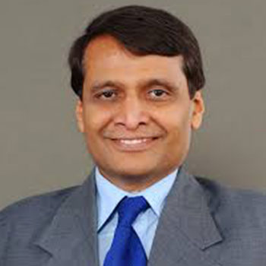
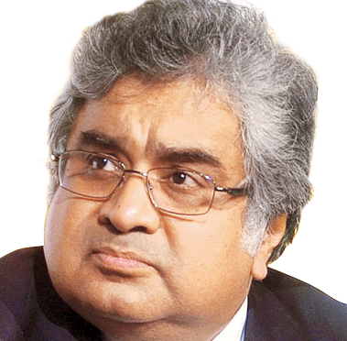
Prominent Chartered Accountants
CA. Piyush Goyal
Union Minister of Commerce & Industry, Consumer Affairs & Food & Public Distribution and Textiles, Government of India.
CA. Suresh Prabhu
Former Union Cabinet Minister, Government of India.
CA. Harish Salve
Former Solicitor General of India.
Senior Advocate in Supreme Court.
He was awarded with the distinguished Padma Bhushan for his contributions in Public Services

Slide 22
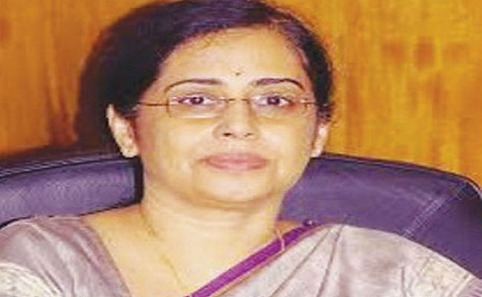
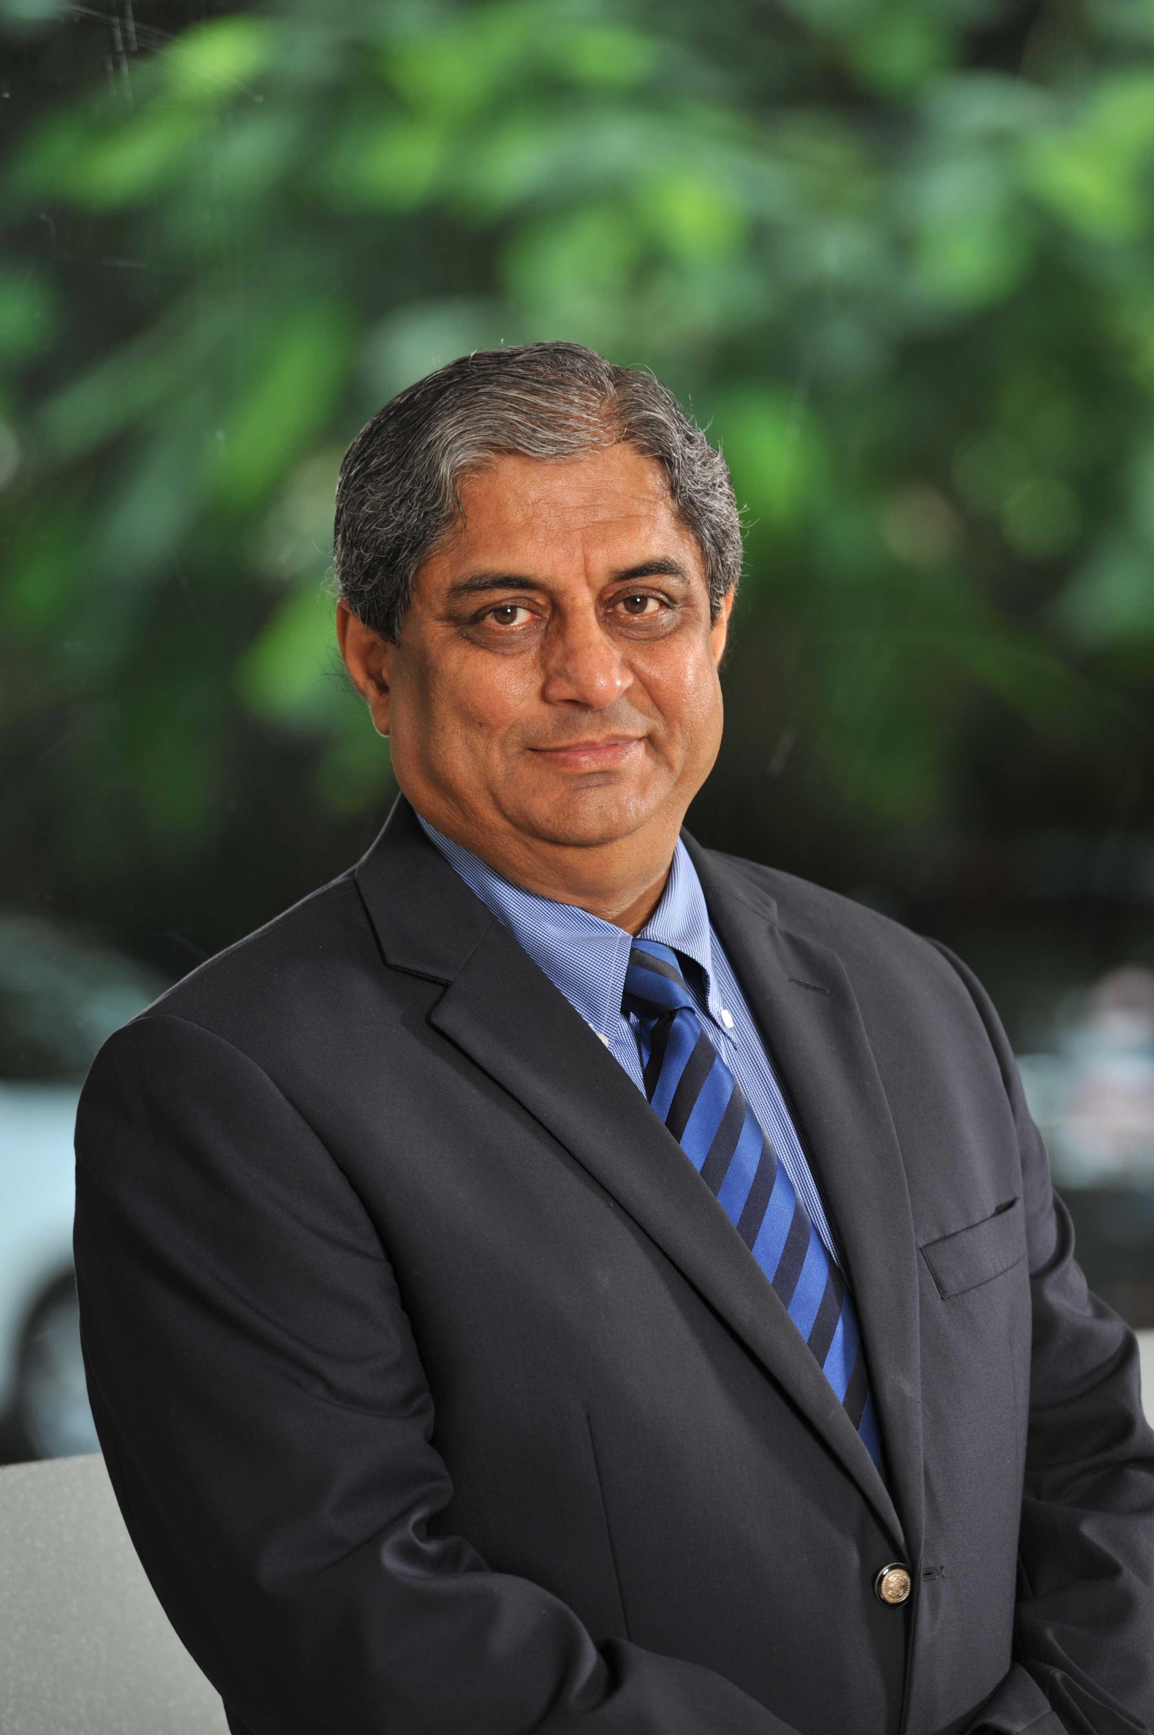
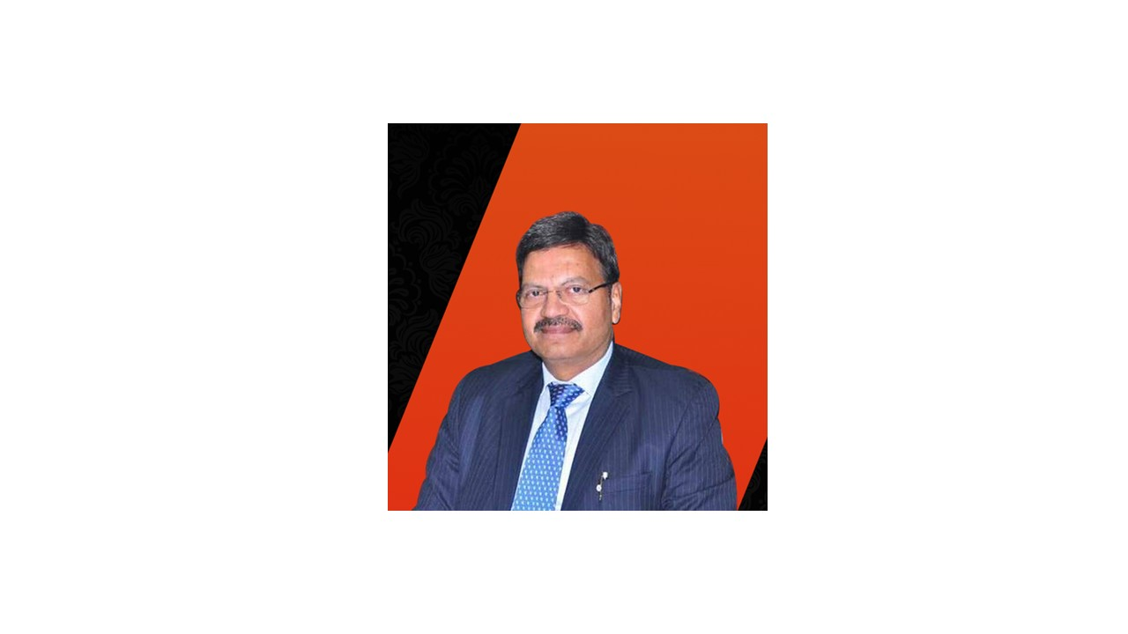
Prominent Chartered Accountants
CA. Sudha Balakrishnan
First ever Chief Financial Officer chosen by the RBI.
CA. Aditya Puri
. Former Managing Director, HDFC
CA. T. N. Manoharan
Former President, ICAI, and Ex-chairman of Canara Bank.
Padma Shri awardee in 2010.

Slide 23
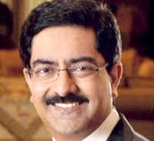

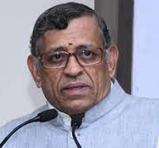
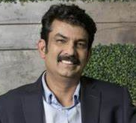
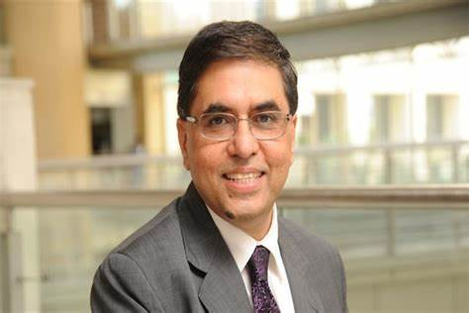
Prominent Chartered Accountants
CA. Kumar Mangalam Birla
. An Indian billionaire industrialist and the Chairman of the Aditya Birla Group, one of the largest conglomerates in India
CA. S Gurumurthy
Chairman, Vivekanand International Foundation. Writer, Journalist, Corporate Advisor
CA. Rajesh Magow
Co-founder & CEO, MakeMyTrip
CA. Sanjiv Mehta
Chairman & MD. Hindustan Unilever Ltd

Slide 24
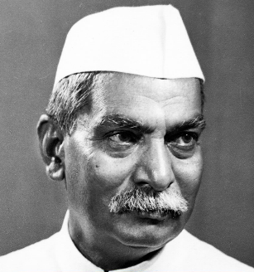
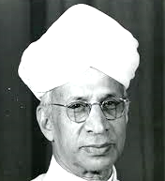

Quotes from distinguished leaders
Dr. Rajendra Prasad
President of India,
1950-62
Dr. S. Radhakrishnan
President of India,
1962-67
“The fast-increasing tempo of the industrial and economic development of the country makes it imperative that every Chartered Accountant should realise that he belongs to a profession which provides the first line of defense to the unwary public against money grabbers and opportunists. Your responsibility in this matter becomes all the greater because of the autonomy, which your profession enjoys.”
“You will help us in maintaining high standards of public behaviour by your frank and candid accounting and auditing. It is therefore essential that you maintain high standards...Whatever profession you might follow, you should not forget that everyone is an artist in his own line, whether it is in accounting or auditing, writing or doing the job of a sculptor or a painter.”

Slide 25
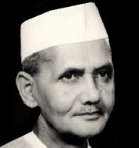
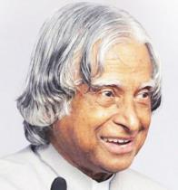
Quotes from distinguished leaders
Shri Lal Bahadur Shastri
Prime Minister of India 1964-66
Dr. APJ Abdul Kalam
President of India
2002 - 2007
“I cannot conceive what would happen if there were no accountants and no auditors. Not only the mute shareholders in a private company but the industries and the economy of the country as a whole would suffer without your help and adequate guidance.”
“I suggest that all the CAs… should take the following oath… I will not only bring out the problems of Financial Management for protecting the interests of the stakeholders of the enterprises, but also suggest possible solution with ethics as a way of life.”

Slide 26
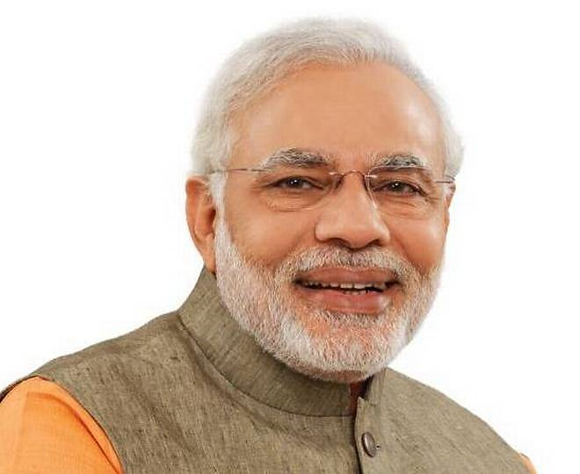
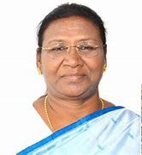

Quotes from distinguished leaders
Shri Narendra Modi
Hon’ble Prime Minister of India
Smt. Droupadi Murmu
Hon’ble President of India
“The Chartered Accountant Fraternity is the 'Pillar of Economic Governance'. You have been entrusted with an important responsibility of reflecting the real health of the economy. There are more than 3.5 lakh-chartered accountants in the country. It is a matter of special happiness that the percentage of women in this profession is increasing day by day. I hope that in the year 2047, when the country will celebrate the centenary of independence and your institute will also be close to the centenary year, they will account for 50 per cent of the total practicing-chartered accountants.”
“Yours is a profession in the society that has the capacity to save this entire economy and keep it growing… A Chartered Accountant’s role should be such that he knows that he is not working just to add and subtract these numbers between 0 to 9, but he should feel that he is playing an important role in building the economic infrastructure of this nation.”

Slide 27
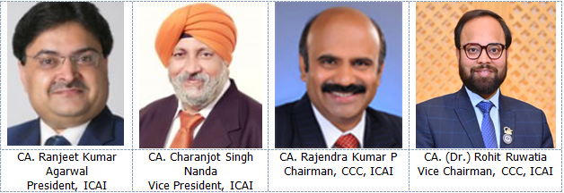
Committee on Career Counselling of ICAI

Slide 28

The Institute of Chartered Accountants of India
COMMITTEE ON CAREER COUNSELLING
“ICAI Bhawan”, A-29, Sector-62, Noida (U.P.) P.C.-201309
Phone: 0120-3876871, Toll-Free-1800 202 8371, E-mail: ccc.secretary@icai.in

